Slide 1

Project Solar
An enterprise to facilitate clean energy

Slide 2
Overview of Agenda
Team introduction and project background
Application of Scrum
Overview of project timelines and milestones
Live demonstration of the project
Project viability and conclusion

Slide 3
Team10 - Scrum Lords
Daksh Mehta - 20012280
Atul Gupta - 20015539
Yash Bhutoria - 20011061
Riddhi Mahesh Dange - 20012299
Nikita Vanga - 20016333
Shrey Tanna - 20015585
Kirtana Sridharan - 20011879

Slide 4
Background
Solar currently meets only 3% of energy needs in the US.
Move towards various forms of green, renewable energy is the need of the hour. Among these, solar energy has proven to be consistent and reliable.
Implementation of Solar energy can reduce utility bills.
In the long term, it can make homes energy independent and take significant load off the main grid.
Customers need an easy and efficient way to take the move towards Solar energy.

Slide 5
Solution
A central, standard project management portal that connects expertise from various skills involved in successful implementation of a local solar energy project.
The portal will facilitate the customer to get in touch with expert engineers and vendors who will take responsibility of the project and see through its implementation.
The portal will facilitate a sales team to maintain communication with the customer, an engineering team that works on the project as well as a management team that oversees the entire process.
The portal will serve as an end-to-end destination for customers who want to take the step towards solar energy.

Slide 6
Solution Overview
The portal brings together 4 entities: Sales team, Engineering team, Management team and the customers.
The customer contacts the Sales team to discuss implementing a Solar project.
The Sales team member takes ownership of the call, understands and documents customer needs.
The case is then sent to the management team for approval. The management team reviews the various aspects of the case and approves it.
Then the case is handed over to the engineering team who implements it end-to-end.

Slide 7
Development Framework - Scrum
The entire project was implemented using Scrum as the project management framework.
Scrum is a highly flexible Agile project management framework that focuses on iterative and incremental development. It consists of three major roles: the Product Owner, the Scrum Master, and the Development team.
Scrum provides an Agile framework for managing and completing complex development projects.
It prescribes dividing the large project into trackable and manageable user stories and planning development in the form of ‘sprints’.

Slide 8
Application of Scrum
Every team member fully committed themselves to practicing scrum throughout the development of the project.
We started by forming a cross-functional team bringing diverse skills from various backgrounds; defining a vision for the project; planning and executing sprints; conducting regular standups, sprint reviews, and sprint retrospectives; and tracking our progress through various visual tools.
We started working on February 22, 2023. Before starting, we finalized 3 user stories that need to be worked on and confirmed the same with the Product Owner.
After this, we played ‘Planning Poker’ to assess the size of every user story. We estimated the time required for the stories to be 1750, 1200 and 1210 minutes respectively.

Slide 9
Scrum continued…
Once we had the estimates, we started working on project development.
During this time, we picked the user stories and tasks that aligned with our interests and capabilities and resolved any issues arising during the process through mutual understanding and cooperation.
Each member than took ownership of their user story and task. We stayed in touched with each other through regular standups until the end of the sprint.
At the end of the sprint we conducted sprint retrospective to reflect on the current sprint and sprint planning to plan for the next one.
We repeated the process until the very end of the project improving our understanding as well as implementation of scrum each time.

Slide 10
Project Timeline
Sprint | Start | End
Sprint 1 | February 22 | March 7
Sprint Retrospective, Sprint Planning
Sprint 2 | March 8 | March 28
Sprint Retrospective, Sprint Planning
Sprint 3 | March 29 | April 11
Sprint Retrospective, Sprint Planning
Sprint 4 | April 12 | April 25
Sprint Retrospective

Slide 11
User Stories
Story ID | Story name | Story description
US01 | Create new projects | As a sales member, I want to be able to create new projects in the system typically after connecting with the customer.
US02 | View my sales/projects | As a sales member, I want to be able to view all the projects I have started and/or are currently assigned to me.
US03 | Engineer views projects | As an engineer, I should be able to view all the projects that are in engineering phase so I can review the progress on these projects. And I should be able to take and upload required pictures for it.
US04 | Engineer sends project to management team for approval. | As an engineer, I should be able to send the project to management team for approval.

Slide 12
User Stories
Story ID | Story name | Story description
US05 | Managers approve a project | As a manager, I should get a notification that a new project has been started. And I should be able to approve/reject the project.
US06 | Managers view currently ongoing projects | As a manager, I should be able to view and track progress of all the projects that are currently ongoing.
US07 | Customer connects with the sales team | As a customer, I should be able to connect with the sales team to discuss and get details on the projects that are viable for me.
US08 | Customer tracks progress on his projects | As a customer, I should be able to track progress of all the projects that I currently have.

Slide 13
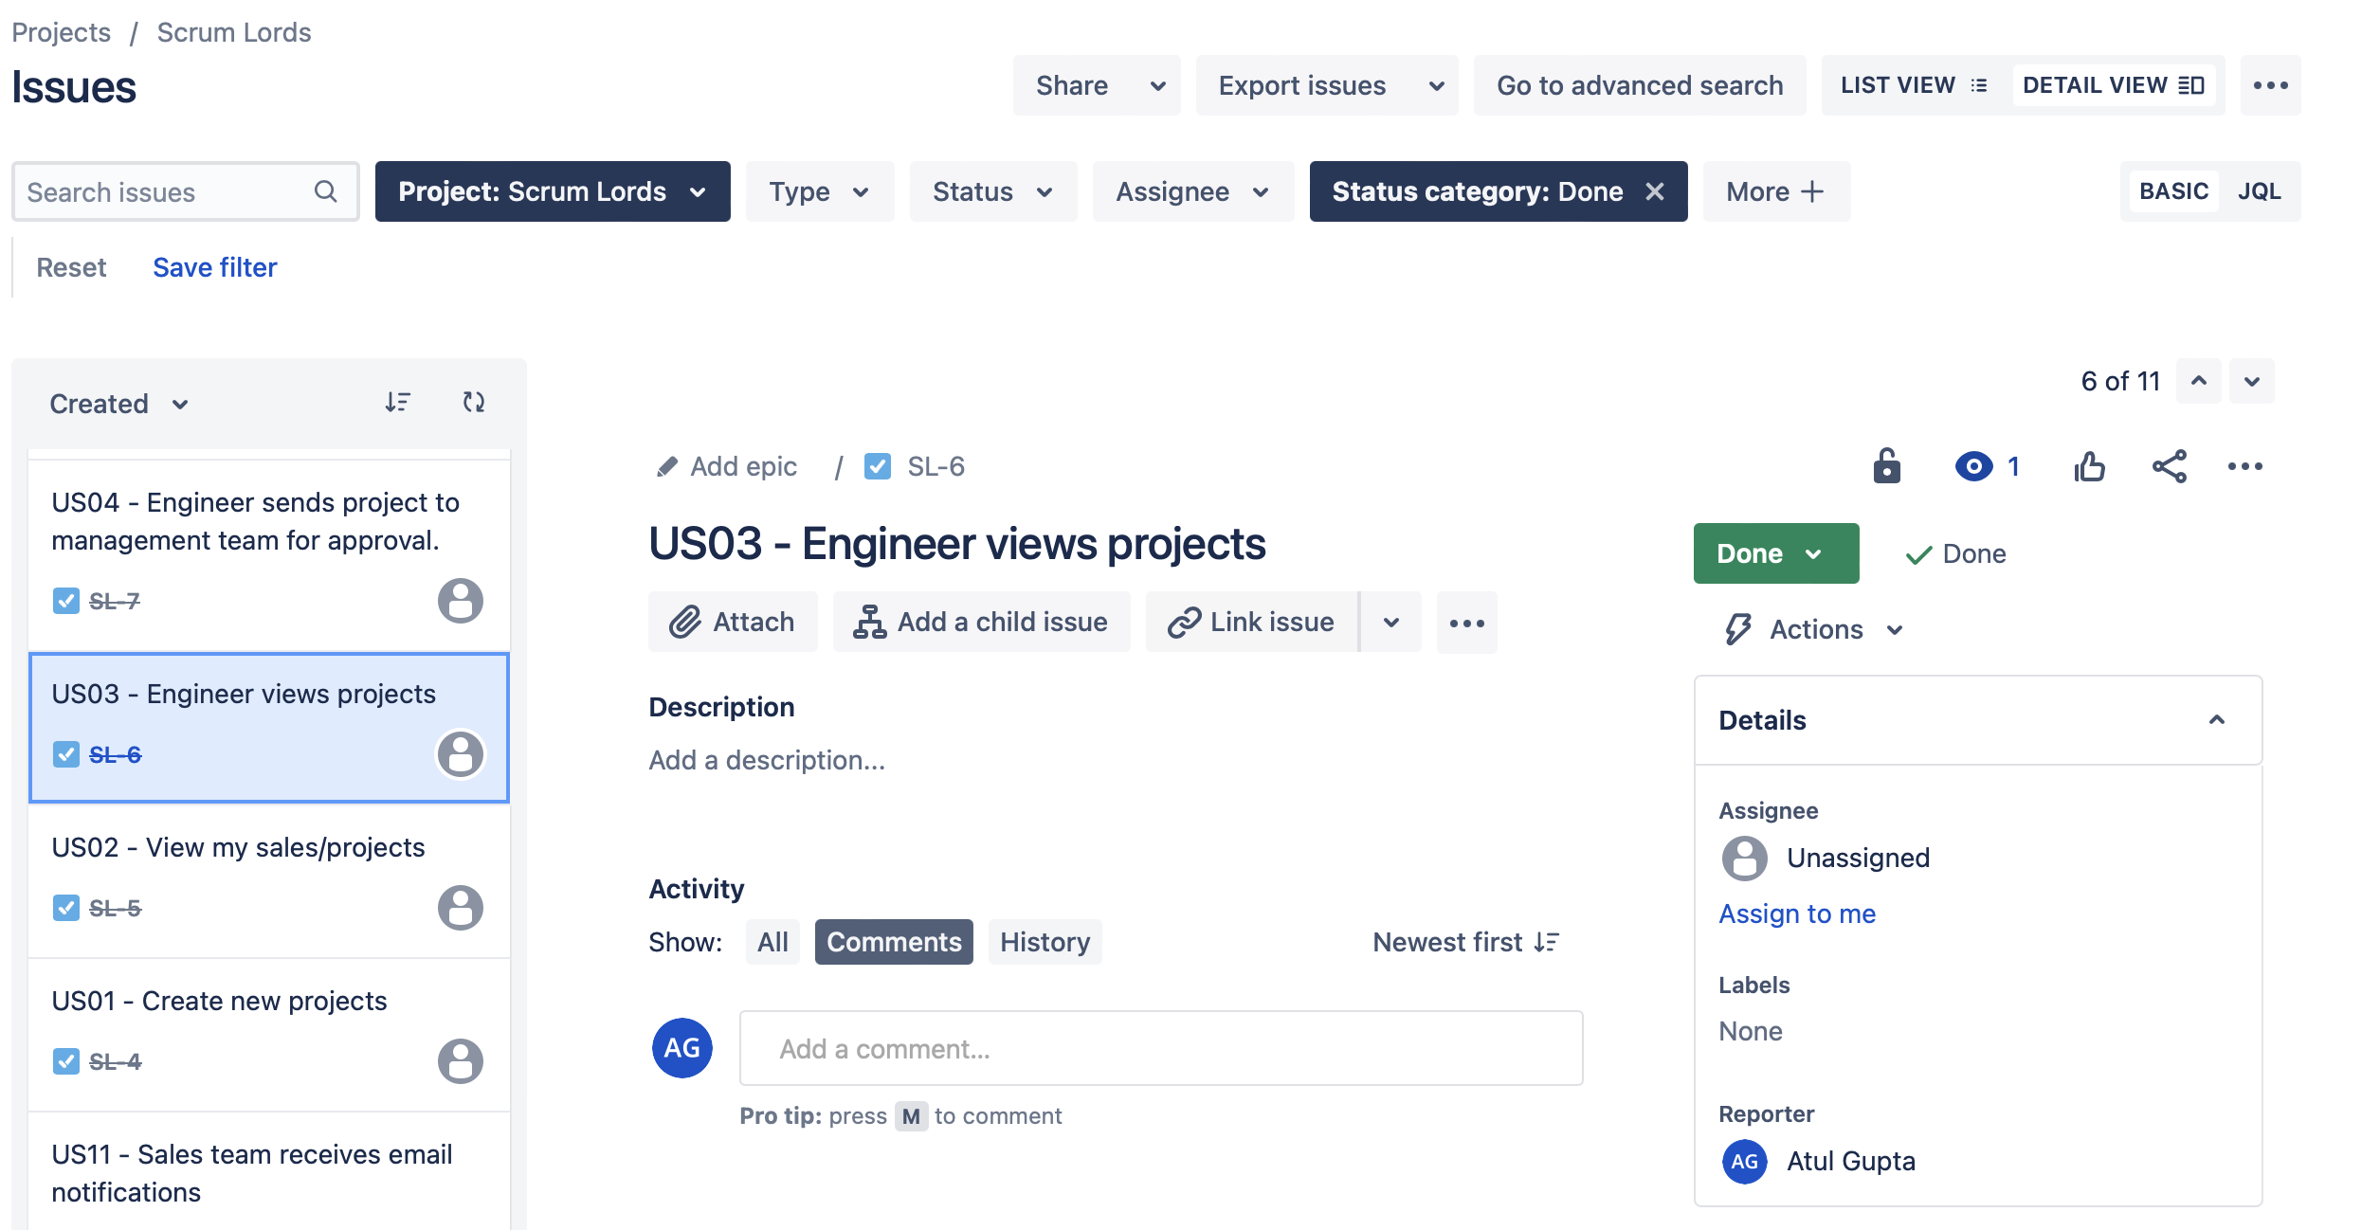
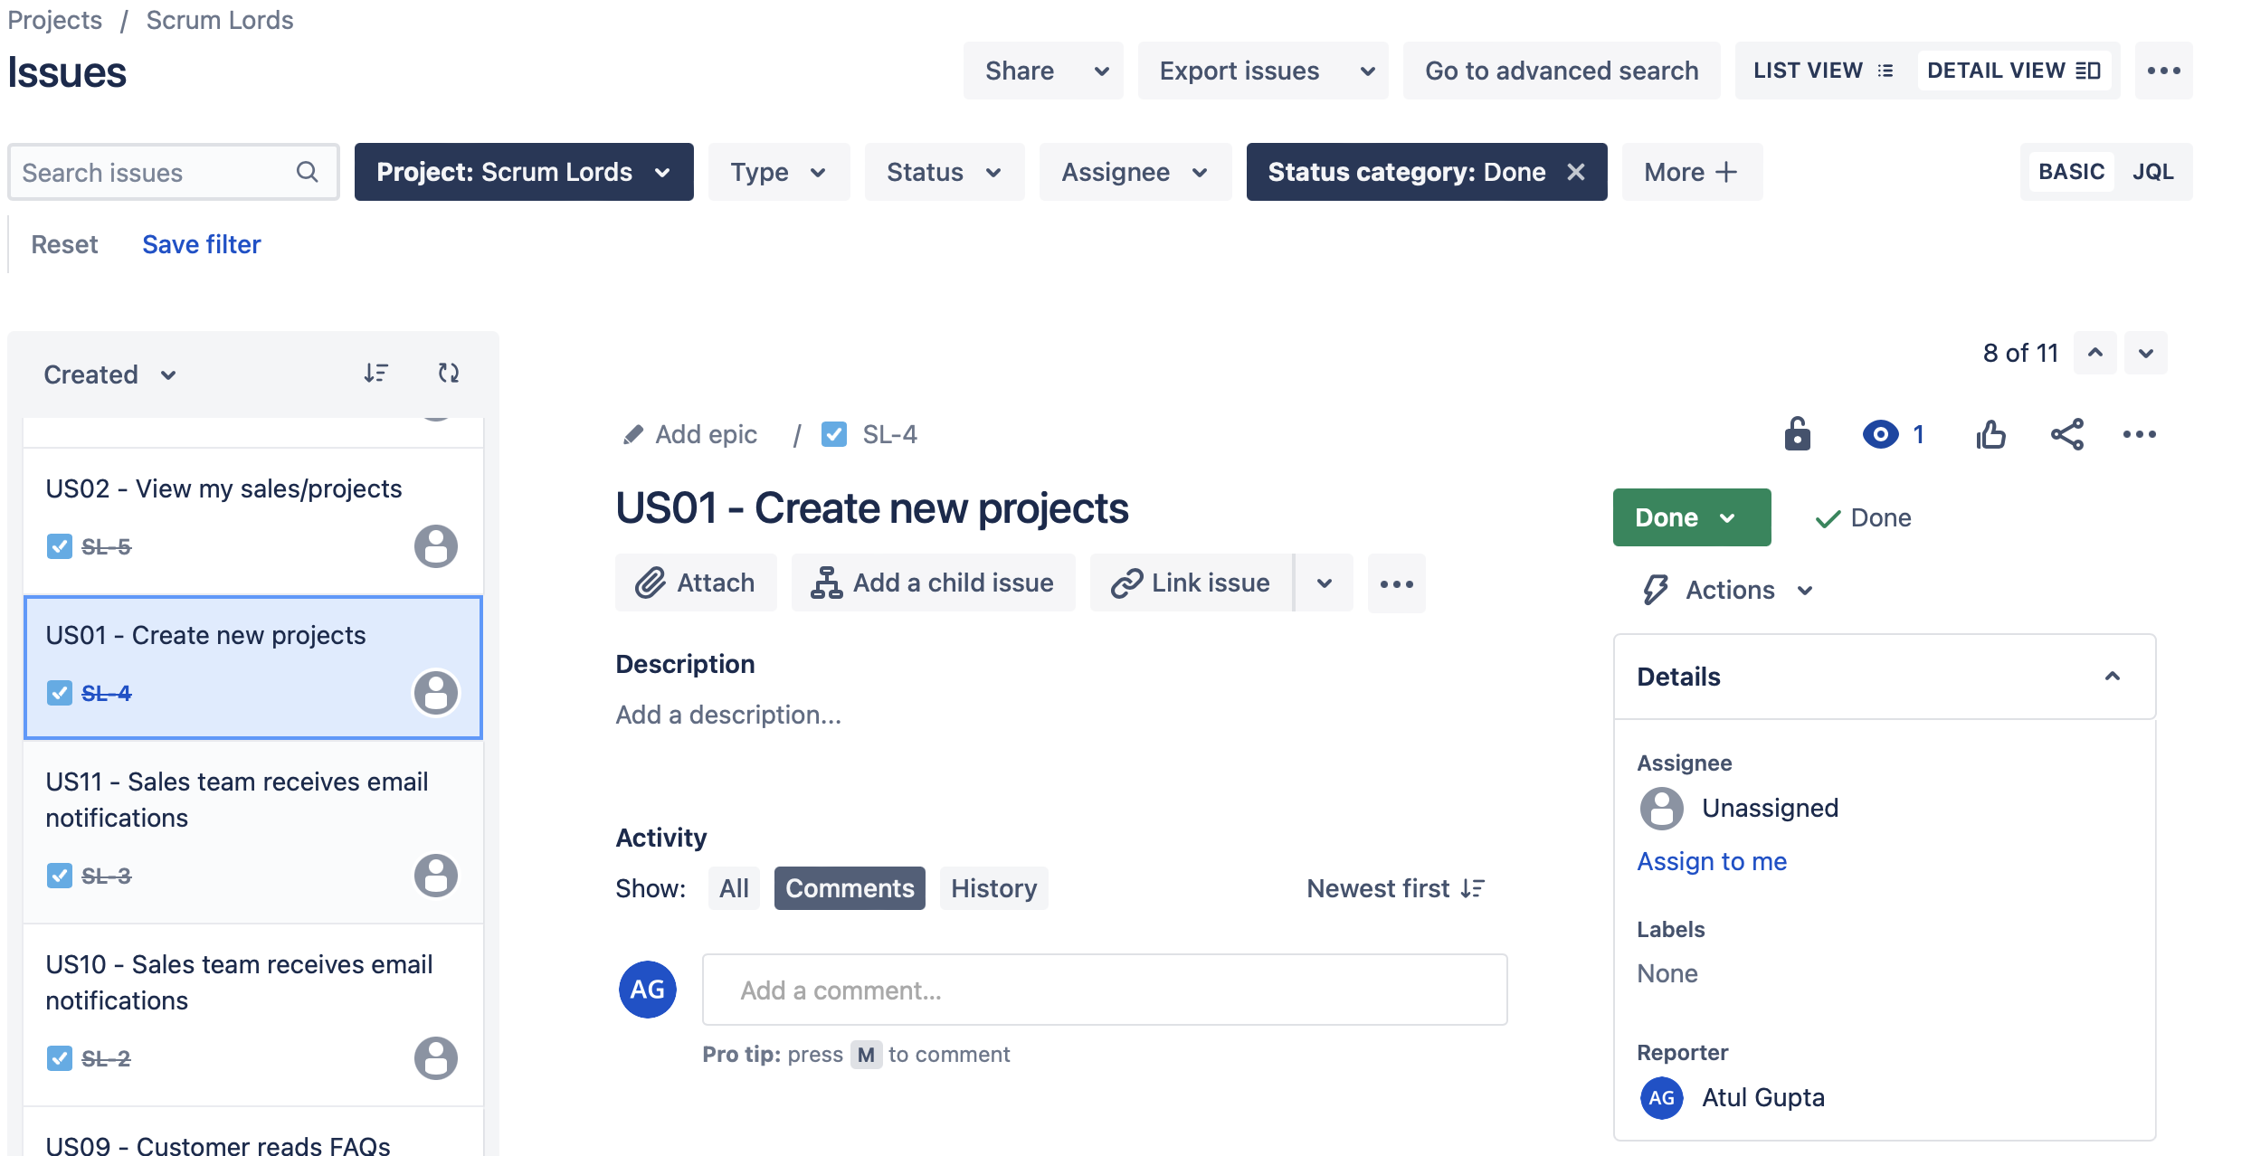
Application of JIRA

Slide 14
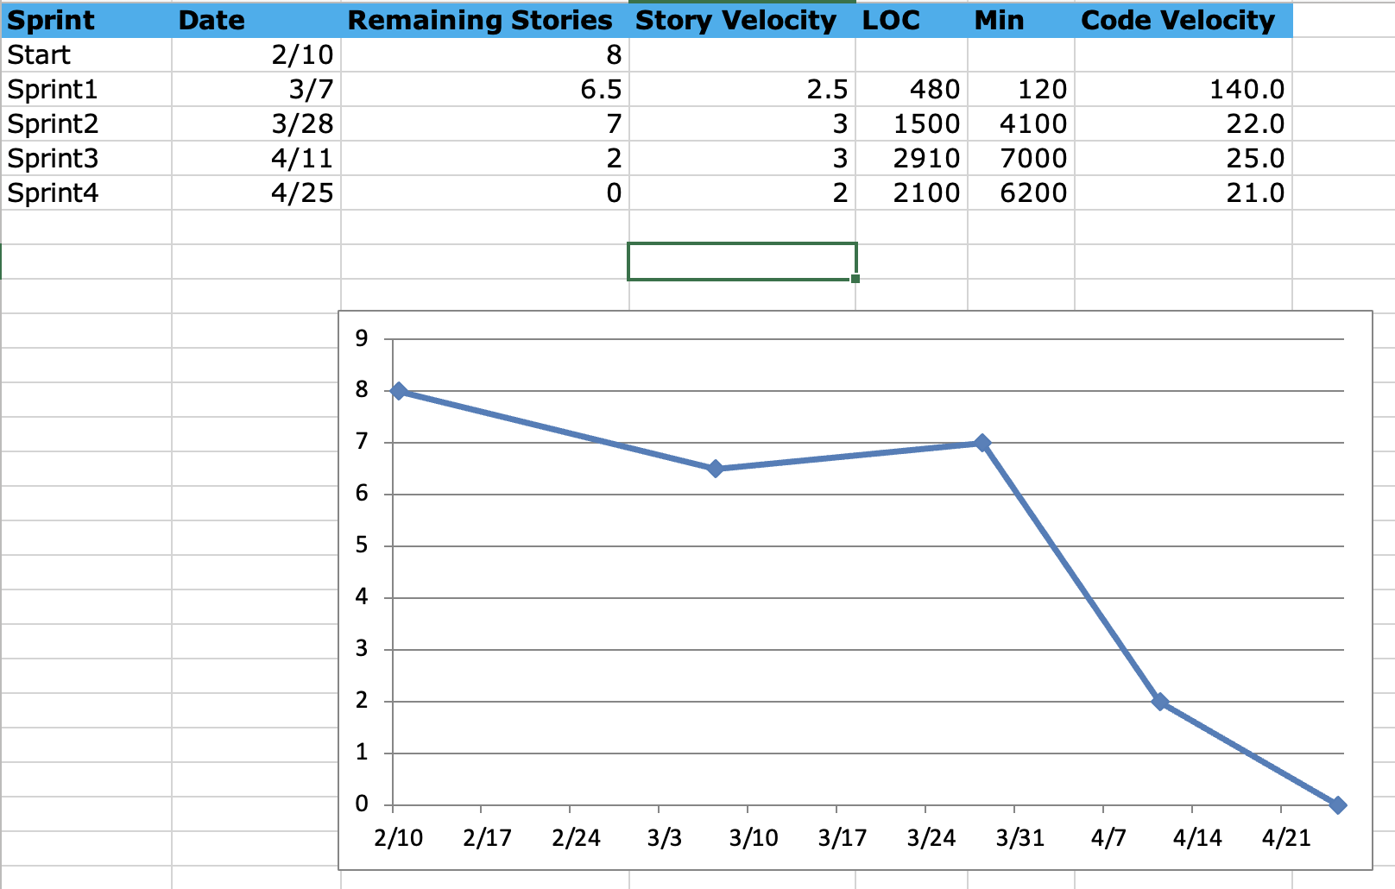
Burndown Chart

Slide 15
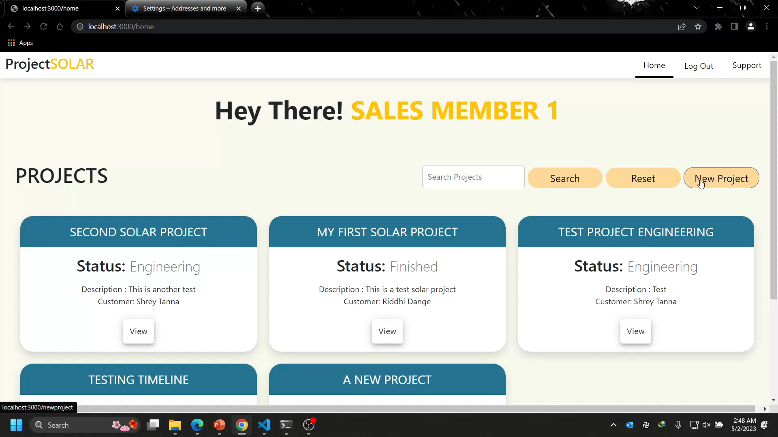
Sales team creates projects

Slide 16
HTML5, CSS (bootstrap), EJS
Node - Express
MongoDB
Tech Stack

Slide 17
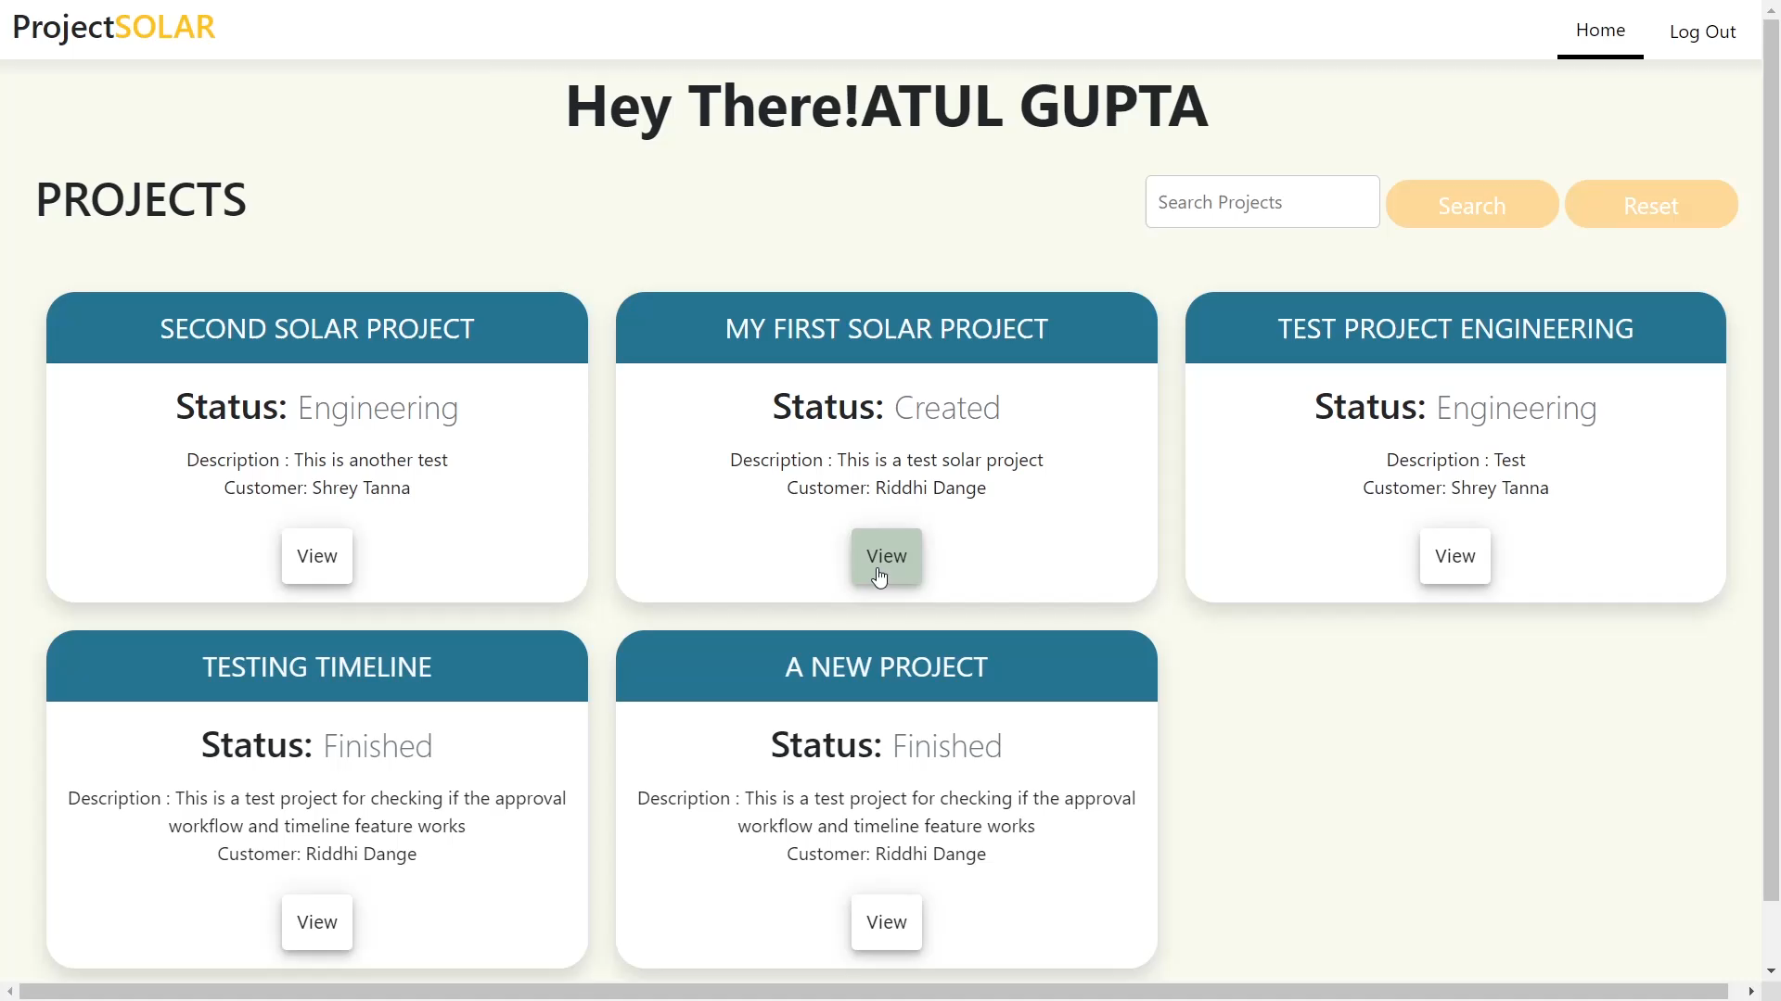
Managers view, study and initiate a project

Slide 18
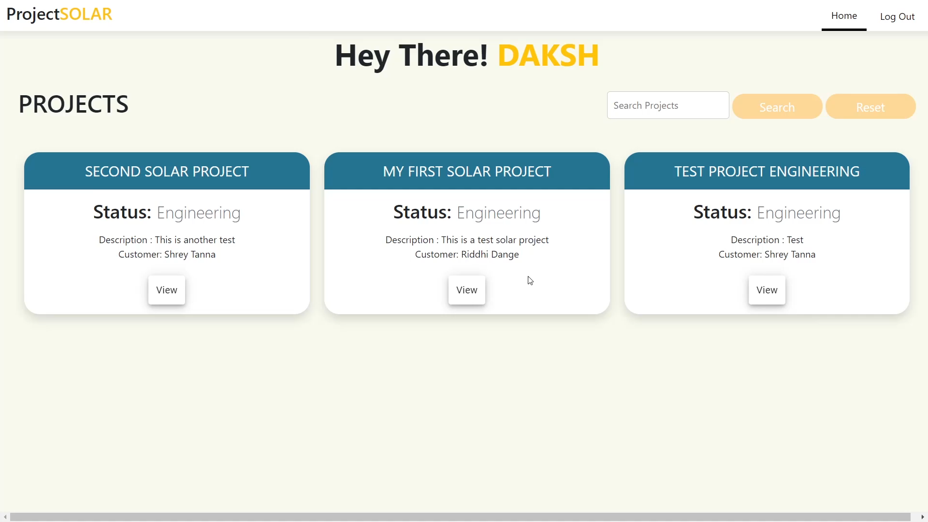
Engineer views projects in the queue and implements them

Slide 19
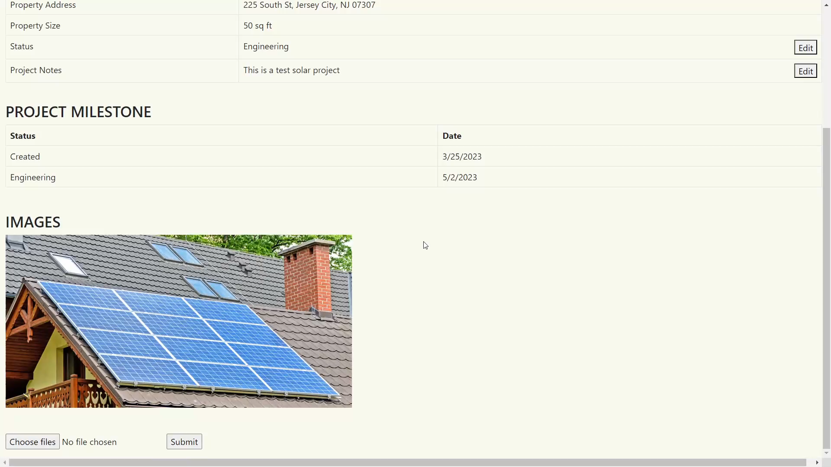
Engineer sends the project to management team for closure

Slide 20
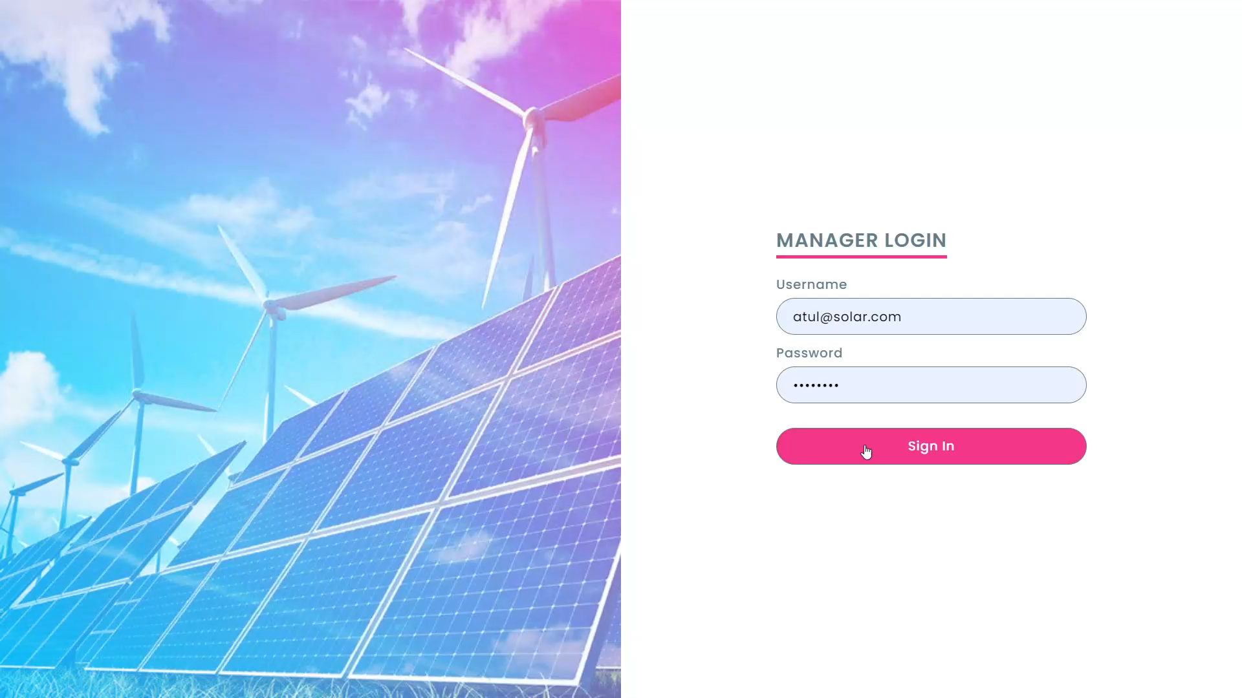
Manager views the completed project and approves it

Slide 21
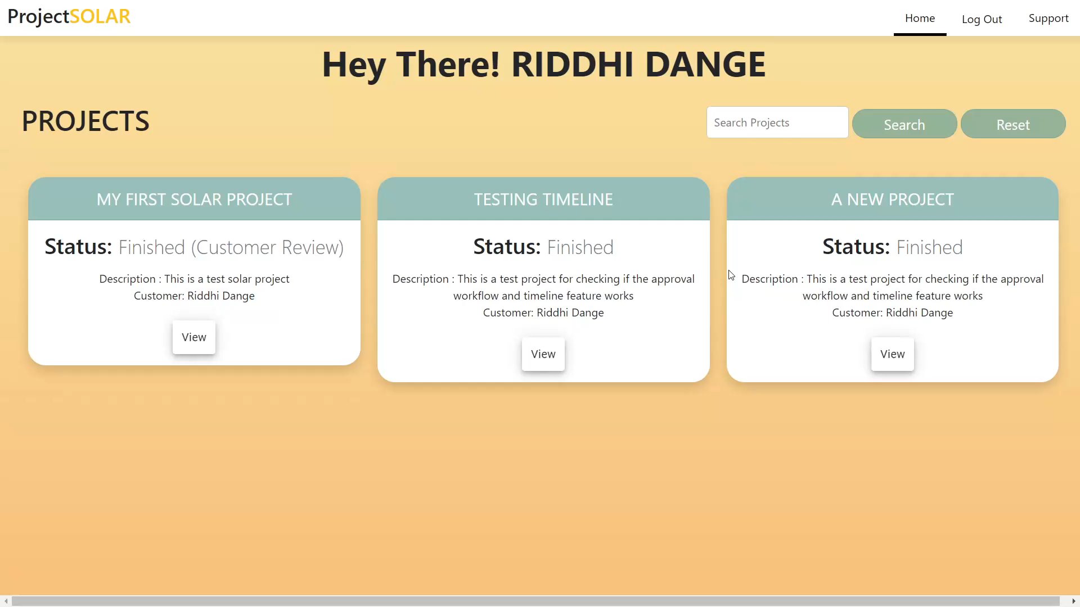
Customer tracks progress on their projects

Slide 22
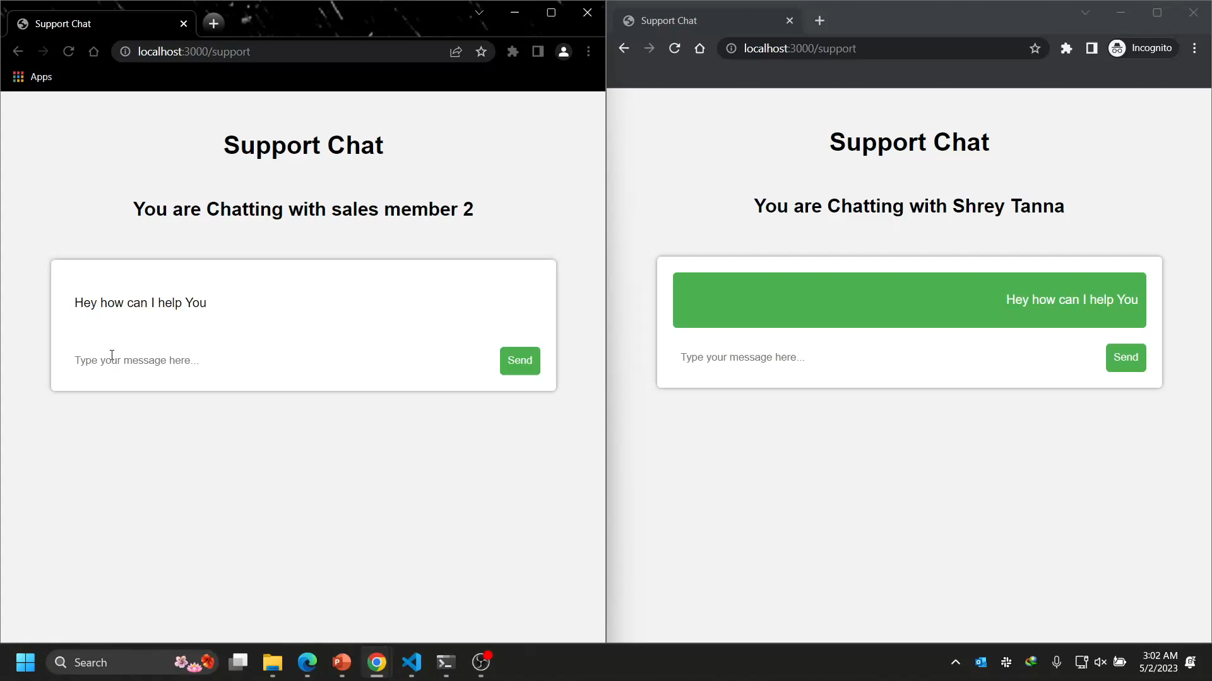
Customer can initiate chat with support team in case of issues

Slide 23
Thank You
Go Green. Go Solar.

